Slide 1

S.S.V.P.S’s B.S.Deore Polytechnic, Dhule
Department of Computer Engineering
Presentation
on
Sub: Network and Information Security
by
Mr. Vishal S. Thakare
B.E. (Computer Engg.)
M.E. (Computer Engg.)

Slide 2
Unit 5 – Network Security, Cyber Laws
and Compliance Standards
14 Marks

Slide 3
Kerberos
it is a network authentication protocol designed to provide strong authentication for client/server application.
It allows nodes communicating over a non secure network to prove their identity to one another in a secure manner.
It is often called third party trusted authentication server.
It keeps the database of all its users and their private keys.
It provides a secure means of authentication over insecure networks.

Slide 4
Terminologies in Kerberos
Client: A client that wants to use a service.
Authentication Server (AS): it runs of KDC server. It authenticates a client logon and issues a ticket granting ticket(TGT) for future authentication.
Ticket-Granting Server (TGS) : it runs on key distribution center. It grants ticket (SGT) to clients for a specific application.
Service Server(SS) : a server that provides useful service that client want to access.

Slide 5
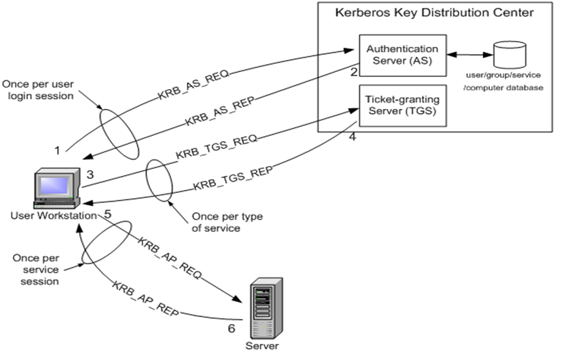
Kerberos

Slide 6
Kerberos
Step 1: The user logs on to the workstation and requests service on the host. The workstation sends a message to the Authorization Server requesting a ticket granting ticket (TGT).
Step 2: The Authorization Server verifies the user’s access rights in the user database and creates a TGT and session key.
Step 3: When the user wants access to a service, the workstation client application sends a request to the Ticket Granting Server containing the client name and a timestamp. The user proves his identity by sending TGT with the session key received in Step 2.

Slide 7
Kerberos
Step 4: The TGS decrypts the ticket and authenticator, verifies the request, and creates a SGT for the requested server.
Step 5: The client application now sends a service request to the server containing SGT received in Step4. The server verifies that the ticket and authenticator match, and then grants access to the service.

Slide 8
IP Security Overview
The IP packets contain data in plaintext form that is anyone watching the IP packet passes by can read the data and even change it.
So the higher level protocols are used to protect the IP packets.
Thus there is a need to secure IP packets themselves.
So the IPSec protocol is designed to provide secure communication across LAN, WAN, and internet.
Main feature of IPSec enables to encrypt or authenticate all traffic at IP level.

Slide 9
IP Security Overview
IPSec is a collection of protocols designed by the Internet Engineering Task Force (IETF) to provide security for a packet at the network level.
IPSec helps create authenticated and confidential packets for the IP layer.
The protocol operate in networking devices like router, firewall, etc.
These devices encrypt and compress all traffic going into WAN and decrypt and decompress traffic coming from WAN.

Slide 10
Applications of IPSec
Secure remote internet access.
Secure branch office connectivity.
Setup communication with other organization.

Slide 11
Modes of IPSec
IPSec operates in one of two different modes:
transport mode or
tunnel mode.

Slide 12
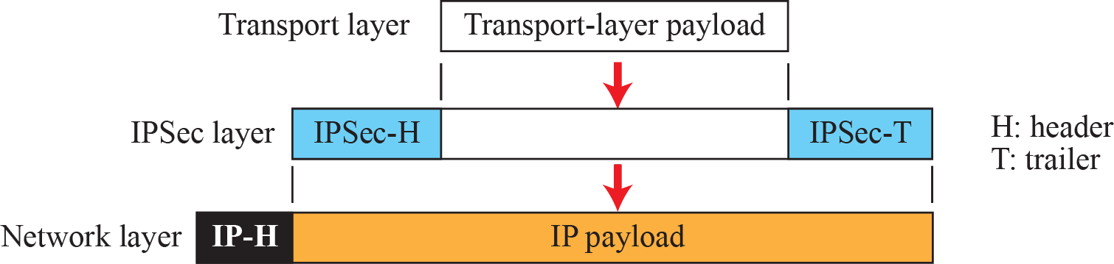
Transport Mode
In transport mode, IPSec protects what is delivered from the transport layer to the network layer.
In other words, transport mode protects the payload to be encapsulated in the network layer,

Slide 13
Transport Mode
The transport mode does not protect the whole IP packet;
it protects only the packet from the transport layer (the IP-layer payload).
In this mode, the IPSec header (and trailer) are added to the information coming from the transport layer.
The IP header is added later.

Slide 14
Transport Mode
Transport mode is normally used when we need host-to-host (end-to-end) protection of data.
The sending host uses IPSec to authenticate and/or encrypt the payload delivered from the transport layer.
The receiving host uses IPSec to check the authentication and/or decrypt the IP packet and deliver it to the transport layer.

Slide 15
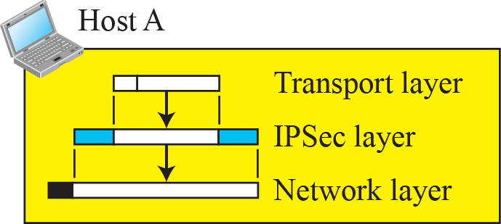
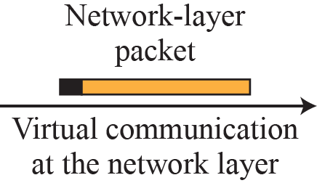
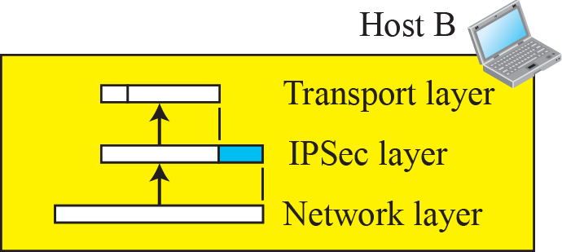
Transport Mode

Slide 16
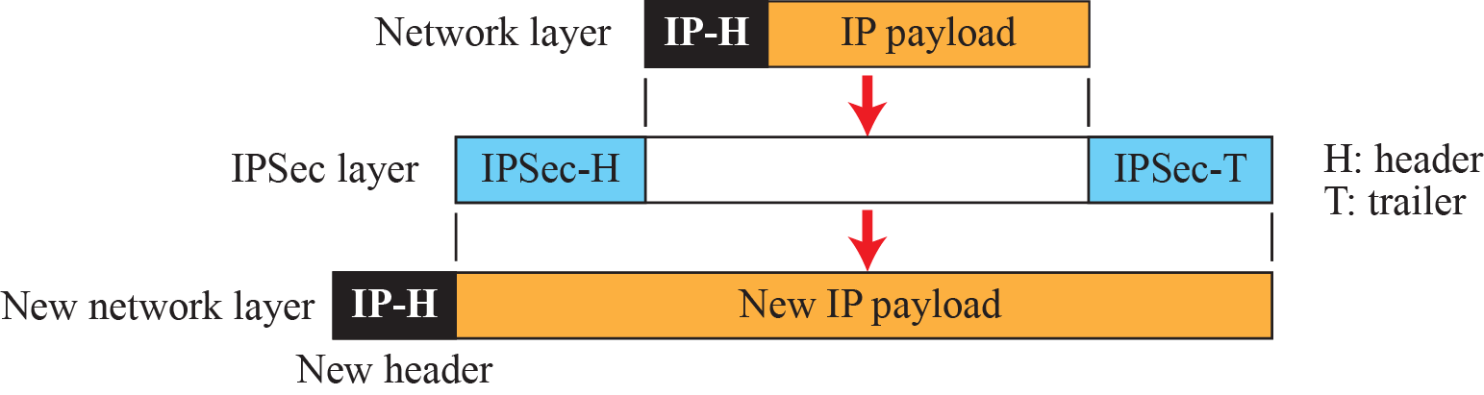
Tunnel Mode
In tunnel mode, IPSec protects the entire IP packet.
It takes an IP packet, including the header, applies IPSec security methods to the entire packet, and then adds a new IP header, as shown in Figure

Slide 17
Tunnel Mode
Tunnel mode is normally used between two routers, between a host and a router, or between a router and a host.
The entire original packet is protected from intrusion between the sender and the receiver, as if the whole packet goes through an imaginary tunnel.

Slide 18
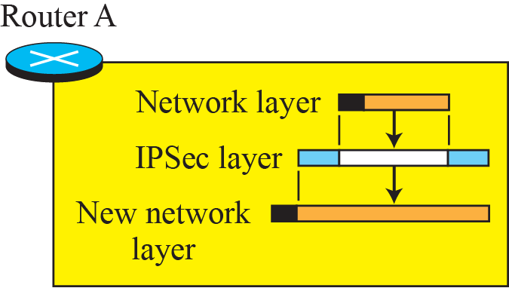

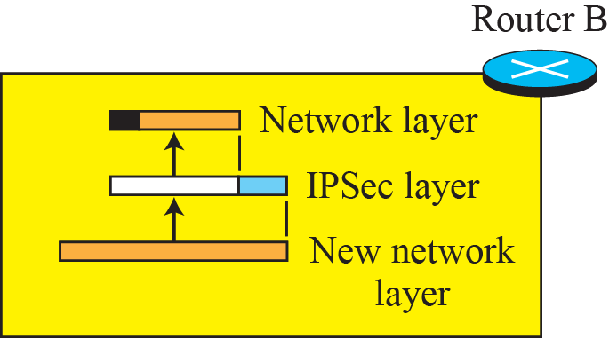
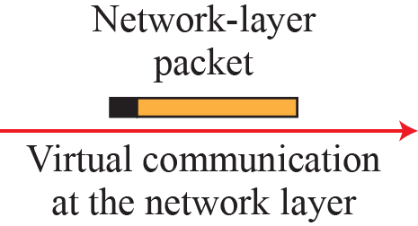
Tunnel Mode

Slide 19
IPSec Protocols
IPSec defines two protocols⎯
the Authentication Header (AH) Protocol and
the Encapsulating Security Payload (ESP) Protocol⎯
To provide authentication and/or encryption for packets at the IP level.

Slide 20
Authentication Header (AH)
The Authentication Header (AH) protocol is designed to authenticate the source host and to ensure the integrity of the payload carried in the IP packet.
The protocol uses a hash function and a symmetric (secret) key to create a message digest;
the digest is inserted in the authentication header.
The AH is then placed in the appropriate location, based on the mode (transport or tunnel).

Slide 21
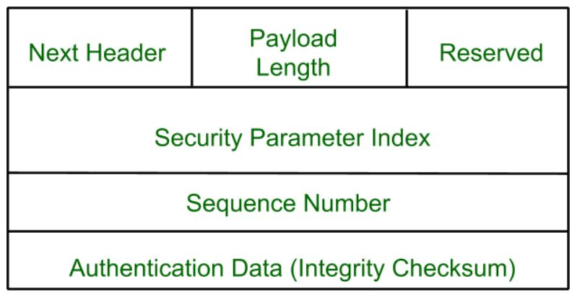
Authentication Header (AH)

Slide 22
Authentication Header (AH)
Next Header: Contains the protocol number of the next header after the AH.
Payload Length: Despite its name, this field measures the length of the authentication header itself, not the payload.
Reserved: Not used; set to zeroes.
Security Parameter Index (SPI): A 32-bit value that when combined with the destination address and security protocol type (which here is obviously the one for AH) identifies the security association to be used for this datagram.
Sequence Number: This is a counter field that is initialized to zero and then incremented for each datagram sent. It is used to provide protection against replay attacks by preventing the retransmission of captured datagrams.
Authentication Data: This field contains the result of the hashing algorithm performed by the AH protocol, the Integrity Check Value (ICV).

Slide 23
Encapsulating Security Payload (ESP)
The AH protocol does not provide confidentiality, it provides only source authentication and data integrity.
IPSec later defined an alternative protocol, Encapsulating Security Payload (ESP), that provides source authentication, integrity, and confidentiality.
ESP adds a header and trailer.

Slide 24
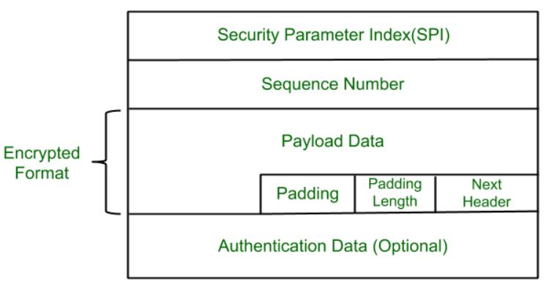
Encapsulating Security Payload (ESP)

Slide 25
Encapsulating Security Payload (ESP)
Security Parameter Index(SPI): This parameter is used in Security Association. It is used to give a unique number to the connection build between Client and Server.
Sequence Number: Unique Sequence number are allotted to every packet so that at the receiver side packets can be arranged properly.
Payload Data: Payload data means the actual data or the actual message. The Payload data is in encrypted format to achieve confidentiality.
Padding: Extra bits or space added to the original message in order to ensure confidentiality. Padding length is the size of the added bits or space in the original message.
Next Header: Next header means the next payload or next actual data.
Authentication Data This field is optional in ESP protocol packet format.

Slide 26
Electronic -Mail
Electronic mail (or e-mail) allows users to exchange messages.
It allows user to send the message in electronic mode over the internet.

Slide 27
Components of the Email System
1) User Agent
The first component of an electronic mail system is the user agent (UA).
It provides service to the user to make the process of sending and receiving a message easier.
A user agent is a software package (program) that composes, reads, replies to, and forwards messages.

Slide 28
Components of the Email System
2) Message Transfer Agent:
The actual mail transfer is done through message transfer agents.
To send mail, a system must have the client MTA, and to receive mail, a system must have a server MTA.
The formal protocol that defines the MTA client and server in the Internet is called the Simple Mail Transfer Protocol (SMTP).

Slide 29
Components of the Email System
3) Message Access Agent :
It is used to access or retrieve the mail from mail server by the receiver.
The protocols used are Post Office Protocol version 3 and Internet mail access protocol (IMAP)

Slide 30
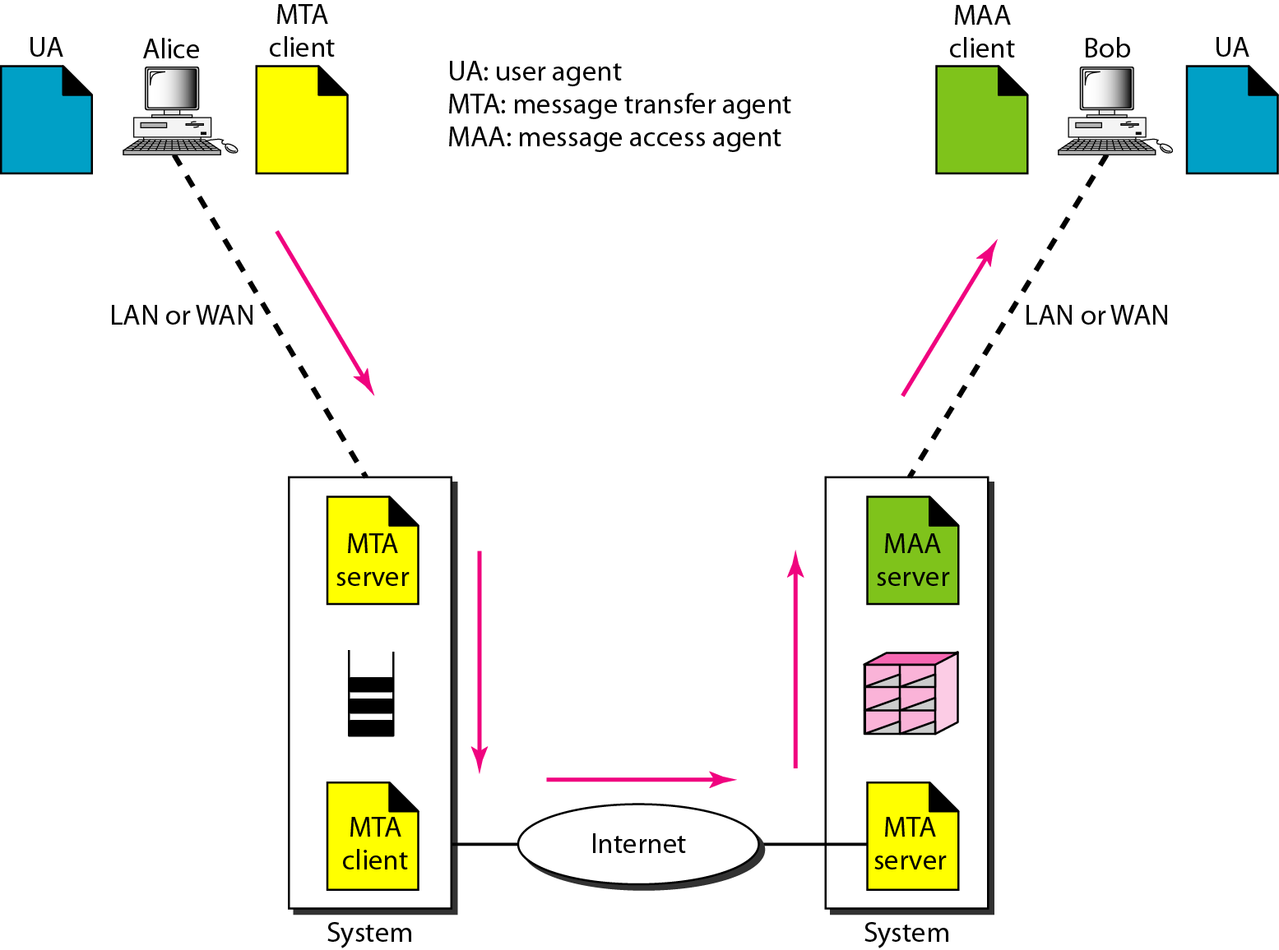
Electronic –Mail Architecture

Slide 31
Email Security
Email is the most widely used application on internet for exchanging business information.
So security of Email is an important issue.
The email exchanges can be secured using two application layer security protocols:
Preety Good Privacy (PGP)
Secure multipurpose internet mail extensions (S/MIME)
Privacy Enhanced Mail (PEM)

Slide 32
Preety Good Privacy (PGP)
It is the popular program used to encrypt and decrypt the email over internet.
It supports the basic cryptographic requirements and is simple to use.
It includes following operations:
Digital signature
Compression
Encryption
Digital Enveloping

Slide 33
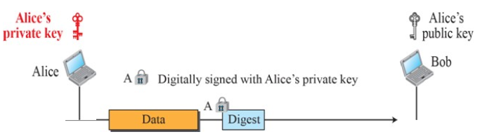
Preety Good Privacy (PGP)
1) Digital Signature

Slide 34
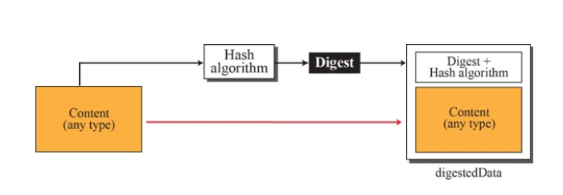
Preety Good Privacy (PGP)

Slide 35
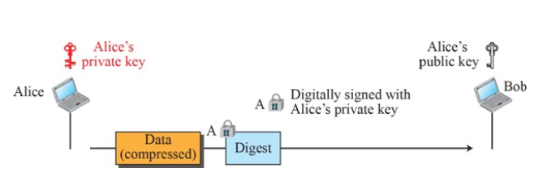
Preety Good Privacy (PGP)
2) Compression

Slide 36
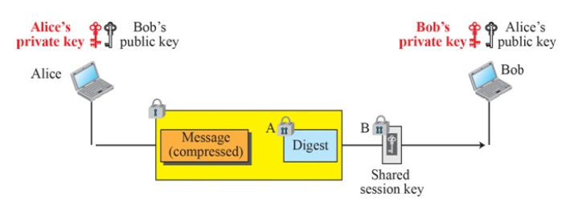
Preety Good Privacy (PGP)
3) Encryption and Enveloping

Slide 37
Simple Mail Transfer Protocol
SMTP is short for Simple Mail Transfer Protocol.
It is an application layer protocol.
It is used for sending the emails efficiently and reliably over the internet.

Slide 38
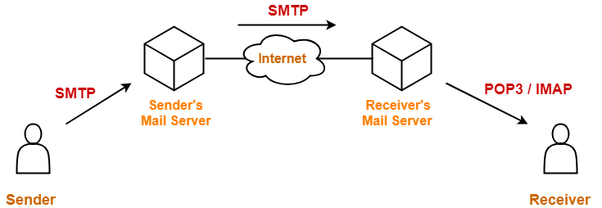
Simple Mail Transfer Protocol

Slide 39
SMTP commands
HELO – used by client to identify itself
MAIL FROM: identifies the originator of the mail
The RCPT TO: identifies the recipient of mail
DATA - has the body of the mail
QUIT - used to terminate an SMTP session
RSET - aborts the current mail transaction
SEND – send mail to terminal
VRFY- Confirm user name.

Slide 40
SMTP response codes
Responses are 3 digit codes sent from server to client
220: The SMTP service is ready
221: SMTP is closing the transmission channel
250: The command has been completed
354: OK to transmit message
450: Command can not be completed because the mailbox is busy

Slide 41
SMTP Operation
The operation of SMTP consists of series of commands and response exchanged between SMTP sender and Receiver.
The basic SMTP operation occurs in three phases.
Connection Establishment
Mail transfer
Connection termination

Slide 42
SMTP Operation
Connection Establishment
The sender opens a TCP connection with the receiver.
Once the connection is established, the receiver identifies itself with '220 Service Ready".
The sender identifies itself with the HELO command.
The receiver accepts the sender's identification with "250 'OK".

Slide 43
Connection Establishment
SMTP SENDER
SMTP Receiver
220 Service ready
Hello xyz.com
250 OK

Slide 44
SMTP Operation
2) Mail transfer
Once the connection has been established, the SMTP sender may send one or more messages to the SMTP receiver.
There are three logical phases to the transfer of a message :
1. A MAIL command identifies the originator of the message.
2. One or more RCPT commands identify the recipients of this message.
3. A DATA command transfers the message text.

Slide 45
SMTP Operation
3) Connection termination
The SMTP sender closes the connection in the following manner:
1. The sender sends a QUIT command and waits for a reply.
2. Sender initiates TCP close operation for the TCP connection.
3. The receiver initiates its TCP close after sending its reply to the QUIT command.

Slide 46
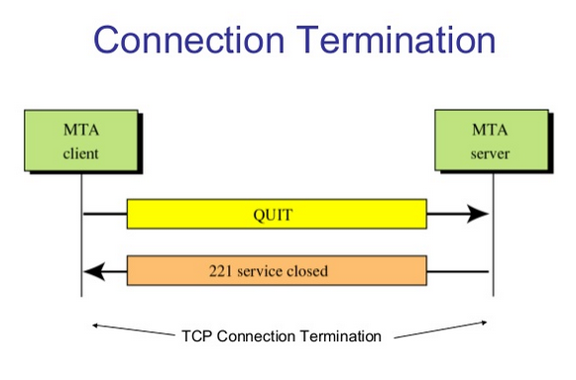
SMTP Operation

Slide 47
Privacy Enhanced Mail
Privacy Enhanced Mail (PEM) is an email security standard to provide secure electronic mail communication over the internet.
It employs the range of cryptographic techniques to allow for confidentiality , sender authentication and message integrity.
the confidentiality allows a message to be kept secret from people to whom the message is not addressed.
The sender authentication allows user to verify that PEM message they have received is send by the required sender only.
The message integrity allow the user to ensure that a message hasn’t been modified during transport from the sender.

Slide 48
Working of PEM :
The PEM works basically in 4 main steps.
Canonical Conversion –
This step involves the conversion of the message into a standard format that is independent of the computer architecture and the operating system of the sender and the receiver.
If the sender and receiver has different computer architecture or operating system.
It may lead to generation of different message digest due to difference in their interpretation because of syntactical difference from one operating system to an other.

Slide 49
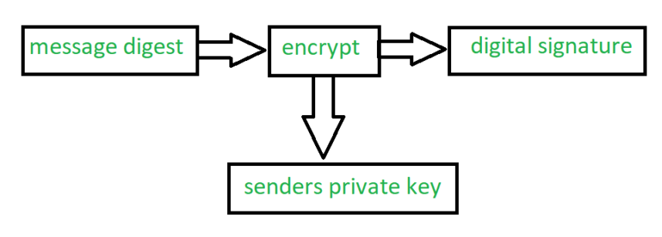
Working of PEM :
Digital Signature:
In this step message digest of the email message using algorithm(MD2, MD5) is obtained.
The message digest is then encrypted with senders private key to form senders digital signature.

Slide 50
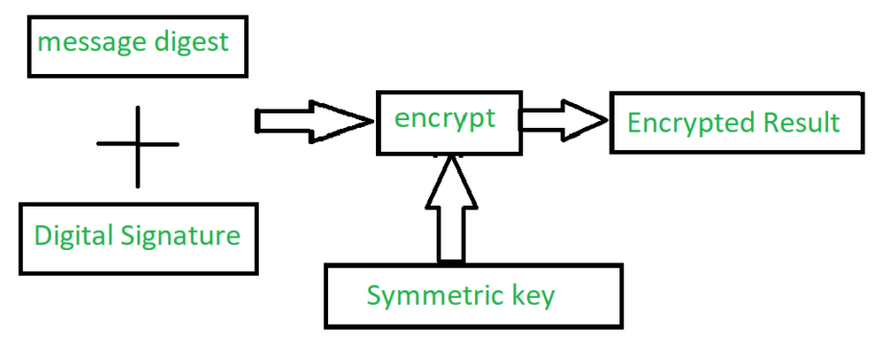
Working of PEM :
Encryption:
The encrypted message is generated by encrypting the original message and digital signature together.
For this encryption DES algorithm is used.

Slide 51
Working of PEM :
Base-64 Encoding
This is the last step where the binary output is transformed into character output.
The binary output which is 24 bits is divided into 4 equal sets and mapped with the 8 bit character output generating a decimal code.

Slide 52
Public-key infrastructure (PKI)
A public-key infrastructure (PKI) is a set of roles, policies, hardware, software and procedures needed to create, manage, distribute, use, store and revoke digital certificates and manage public-key encryption.
The purpose of a PKI is to facilitate the secure electronic transfer of information for a range of network activities such as e-commerce, internet banking and confidential email

Slide 53
Public-key infrastructure (PKI)
PKIs are the foundation that enables the use of technologies, such as digital signatures and encryption, across large user populations.
The most unique feature of PKI is that it uses 2 keys that includes private key and public key.
PKI contains components such as
Digital certificate,
Certificate authority,
Registration authority.

Slide 54
Digital Certificate
Digital Certificate is similar a small computer file.
it is similar to the passport which signifies the difference between the person and his characteristics such as full name, nationality, date of birth, photograph, signature etc.
Digital Certificate signifies Association between person and his public key.
A Digital Certificate is an electronic document that contains a key value and identifying information about the entity that controls the key.
The certificate is often issued and certified by third party usually a certificate authority CA.

Slide 55
Digital Certificate
A digital signature attach to the certificates file, certifies the files origin and integrity.
This verification process often occur when we download or update software via the internet.
Digital certificates are not only given to people but also to computers, software packages or organization.
Digital certificates are based on ITU standard x509 which defines a standard certificate format for public key certificate and is validation.
Hence Digital Certificate are sometimes referred to as x509certificate.

Slide 56
Certificate Authority
A Certificate Authority is a trusted third party entity that issues digital certificates and manages the public keys and credentials for data encryption for the end user.
The responsibility of the CA in this process is to ensure that the company or user receives a unique certificate for an efficient identity authentication.
The government in various countries decide who can be CA.
Usually CA is a reputed organization such as a post office, financial institution, software company etc

Slide 57
Certificate Authority
The CA has the authority to give Certificate to individual person and organization who want to use that certificate in asymmetric cryptosystem application.
The functions of CA are as follows:
Generating key
Issuing Digital Certificate
Publishing certificate
Verifying certificate
Revocation of certificate

Slide 58
Certificate Creation Steps
The user first generates a public/ private key pair.
User keeps the private key and sends the public key to the CA with the user identification information( name, birth date, etc) in the form of a certificate request.
The CA will verify the user identity through a procedure.
If everything is verified, then CA will issue a certificate with user name, email address, etc.

Slide 59
Certificate Creation Steps
The CA creates a signed certificate by creating a message digest and encrypting it with his private key.
This makes sure that no one can modify this certificate.
The certificate is returned to the user, with a copy kept by the CA.

Slide 60
Registration Authority(RA)
As CA can be overloaded with a variety of tasks such as issuing new certificates, maintaining the old ones, etc.
The CA can delegate some of its tasks to the third party called registration authority(RA).
The RA is an intermediate entity between the end users and CA which assists the CA in its day to day activities.

Slide 61
Registration Authority(RA)
The RA commonly provides the following services:
Accepting and verifying registration information about new uses.
Generating keys on behalf of end users.
Revoking certificates.
Validating user certificates.

Slide 62
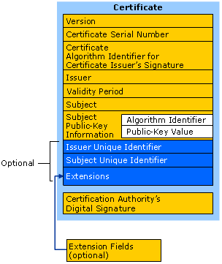
X509/PKIX Certificate format

Slide 63
X509/PKIX Certificate fields
X.509 certificate fields:
version: The version number of the x.509 certificate. (if omitted, version 1 is assumed)
serialNumber: Unique serial number that is created for each certificate that is created by a CA.
Signature algorithm: The algorithm used to generate the signature by the issuer to sign the certificate
issuer: The distinguished name (DN) of the issuing CA.

Slide 64
X509/PKIX Certificate fields
validity: specify the validity period. Two dates of time—from notBefore (issued date) through notAfter (expiry date).
subject: Distinguished name of the validated entity (user) to which the certificate is issued.
subjectPublicKeyInfo: The public-key algorithm and value (RSA, DSA, or Diffie-Hellman).
Issueruniqueidentifier : specify some optional information related to issuer.
Subjectuniqueidentifier : specify optional information related to subject

Slide 65
Cyber crimes
Cybercrime is the activity of using computers and networks to perform illegal activities like spreading computer viruses, performing unauthorized electronic fund transfers, hacking of websites, etc.
Most cybercrime hacks are committed through the internet, and some cybercrimes are performed using Mobile phones via SMS and online chatting applications.

Slide 66
Hacking
Hacking is the activity of identifying weaknesses in a computer system or a network to exploit the security to gain access to personal data or business data.
An example of computer hacking can be: using a password cracking algorithm to gain access to a computer system.
Hacking is also carried out as a way to find out the credit card numbers, internet passwords and other personal information.
There are different types of hackers.

Slide 67
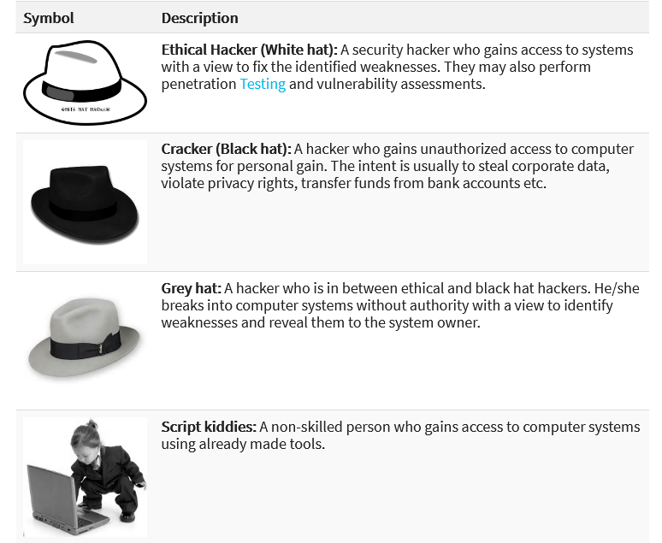

Slide 68
Digital Forgery
Forgery is the criminal act that provides misleading information about a product or service.
It is the process of making, adapting, or imitating documents or objects with the intent to deceive.
It is also called as digital tampering.
It is the process of manipulating documents or images for the intent of financial, social or political gain.

Slide 69
Digital Forgery
The majority of digital forgery occurs because digitally altered pictures often appeal to viewers eyes.
Now a days many powerful picture processing softwares are available(adobe photoshop, coreldraw, etc)
By using this software one can alter almost anything in picture.

Slide 70

Digital Forgery

Slide 71
Cyber stalking
Cyber stalking is the use of the Internet or other electronic means to stalk or harass an individual, group, or organization.
It might target individuals, groups or even organizations.
It takes place via online channels such as social media, forums, email.
A stalker may be an online stranger or a person whom the target knows.
It may include threats of violence by email or text message.
It may feel person afraid or concerned for their safety.

Slide 72
Identity theft and fraud
Identity theft and identity fraud are terms used to refer to all types of crime in which someone wrongfully obtains and uses another person's personal data to create fraud.
Identity theft is committed in many different ways and its victims are typically left with damage to their credit, finances, and reputation.
Identity theft occurs when someone steals your personal information—such as your Social Security number, bank account number, and credit card information.

Slide 73
Identity theft and fraud
The stolen personal data is later resold or used directly for purchasing goods and services online, opening banks accounts, filing fraudulent tax returns, and other illegal purposes.

Slide 74
Cyber Terrorism
Cyber terrorism is any act of terrorism that uses information systems or digital technology.
Cyber terrorism can either be "international", "domestic" or "political“.
Terrorist groups use their own computer technology to threaten or attack a victim's computer resources.
A cyber-terrorist is a criminal who uses computer technology and the Internet, especially to cause fear and disruption.
Some cyber-terrorists spread computer viruses, and others threaten people electronically.
Some ways they do this hacking networks and computers to find out personal information

Slide 75
Cyber Defamation
The term ‘Cyber Defamation’ basically means publishing of false statement about an individual in cyberspace.
It is done with computer as a tool.
Its intension is to harm the reputation of particular person.

Slide 76
Cyber law and its need
Cyber law is the law governing computers and the internet.
Cyber law is important because it touches almost all aspects of transactions and activities and on involving the internet, World Wide Web and cyberspace.
Cyber space includes computers, networks, data storage, devices like HDD, USB Disks, internet, websites, emails, cellphones, ATM machines.

Slide 77
Cyber law and its need
Cyber law can also be described as that branch of law that deals with legal issues related to use of inter-networked information technology.
All legal issues related to internet crime are dealt with through cyber laws.
As the number of internet users is on the rise, the need for cyber laws and their application has also gathered great momentum.
Due to cyber laws, the organizations/companies are now able to carry out E-commerce using legal infrastructure provided by cyber laws.

Slide 78
Categories of Cyber laws
The cyber crime falls into 3 major categories;
Crime against property:
Some online crimes occur against property, such as a computer or server.
These crimes include DDOS attacks, hacking, virus transmission, copyright infringement, and IPR violations.
Crime against individual:
These crimes include cyber harassment and stalking, credit card fraud, spoofing, identity theft, etc.

Slide 79
Categories of Cyber laws
Crime against government:
When a cybercrime is committed against the government, it is considered an attack on that nation's security.
Cybercrimes against the government include hacking, accessing confidential information, cyber warfare, cyber terrorism, and pirated software.

Slide 80
Intellectual property rights
Intellectual property rights are the rights given to each and every person for the creations of new things according to their minds.
IPR usually give the creator a complete right over the use of his/her creation for a certain period of time.
Intellectual property rights are the legal rights that cover the benefits given to individuals who are the owners and inventors of a work and have created something unique with their intellectual creativity or capability.

Slide 81
Intellectual property rights
Every person related to areas such as literature, music, invention, etc., can be granted such rights, which can then be used in the business practices by them.
The creator/inventor gets complete rights against any misuse or use of work without his/her prior information.
However, the rights are issued for a limited period of time to maintain equilibrium.

Slide 82
Types of Intellectual Property Rights:
Copyright: Copyright is a term that describes ownership of control of the rights to the use and distribution of certain works of creative expression, including books, video, movies, music and computer programs.
Patent: A patent gives its owner the right to exclude others from making, using, selling, and importing an invention for a limited period of time. The patent rights are granted in exchange for enabling public disclosure of the invention.

Slide 83
Types of Intellectual Property Rights:
Trademark: A Trademark is a Graphical representation that is used to distinguish the goods and services of one party from those of others. A Trademark may consist of a letter, number, word, phrase, logo, graphic, shape, smell, sound or combination of these things.
Trade Secrets: Trade secret describes about the general formula of any product and the key behind any organization’s progress. It also includes various firms’ different secret formula for same products which differ around quality.

Slide 84
Compliance standards
Information security plays an important role in protecting the data and assets of an organization.
Hence organizations need to be fully aware of the need to protect information and its assets.
Regulations are in place to help companies improve their information security strategy by providing guidelines and best practices based on the company’s industry and type of data they maintain.
Non-compliance with these regulations can result in severe fines, or worse, a data breach.

Slide 85
Compliance standards
Some industries like banking are regulated and the guidelines or best practices put together as a part of those regulations often become a standard between members.
Such good practices can come from many various sources and frameworks like ITIL, COBIT, ISO/IEC 20000, etc.

Slide 86
information security management system (ISMS)
An information security management system (ISMS) is a set of policies and procedures for systematically managing an organization's sensitive data.
The goal of an ISMS is to minimize risk and ensure business continuity by pro-actively limiting the impact of a security breach.
An ISMS typically addresses employee behavior and processes as well as data and technology.

Slide 87
ISO 27001
it is the leading international standard focused on information security, published by the International Organization for Standardization (ISO), in partnership with the International Electrotechnical Commission (IEC).
Both are leading international organizations that develop international standards.
ISO 27001 was developed to help organizations, of any size or any industry, to protect their information in a systematic and cost-effective way, through the adoption of an Information Security Management System (ISMS).

Slide 88
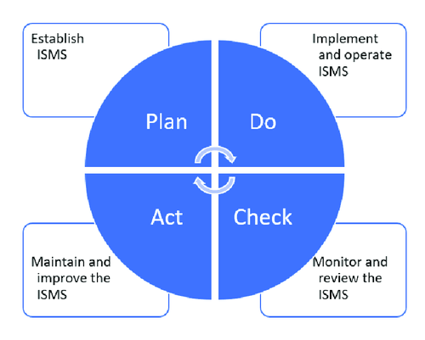
PDCA Model

Slide 89
PDCA Model
Plan (establish the ISMS)
Establish ISMS policy, objectives, processes and procedures relevant to managing risk and improving information security to deliver results in accordance with an organization’s overall policies and objectives.
Do (implement and operate the ISMS)
Implement and operate the ISMS policy, controls, processes and procedures.
Check (monitor and review the ISMS)
Assess and, where applicable, measure process performance against ISMS policy, objectives and practical experience and report the results to management for review.
Act (maintain and improve the ISMS)
Take corrective and preventive actions, based on the results of the internal ISMS audit and management review or other relevant information, to achieve continual improvement of the ISMS.

Slide 90
ISO 20000
ISO 20000 is the international standard for IT Service Management (ITSM), published by ISO (the International Organization for Standardization).
To become an international standard, ISO 20000 had to be agreed upon by a majority of member countries, which means it is accepted by a majority of countries worldwide.
The standard describes a set of management processes designed to help you deliver more effective IT services (both to those within your business and to your customers).
ISO 20000 gives you the methodology and the framework to help you manage your ITSM, while allowing you to prove your company follows best practice.
With the requirements of the standard you will achieve best practice, helping to improve your delivery of IT services.
And ISO 20000 is applicable to any company size and any industry.

Slide 91
ISO 20000
ISO 20000-1:2011 is the formal specification for IT Service Management. It clearly defines all the requirements you need to deliver managed IT services of an acceptable quality for your customers.
It includes:
Service Management System requirements
Design and transition of new or changed services
Service delivery processes
Relationship processes
Resolution processes
Control processes

Slide 92
ISO 20000
The second part: ISO 20000-2:2012 is the code of practice for IT service management;
it is the guidance of the application of service management systems.
In other words, it helps you interpret the requirements of the standard.
It defines the best practice management processes, and is very useful if you’re preparing to be audited against ISO 20000 or planning service improvements.

Slide 93
COBIT Framework
Control Objectives for Information and Related Technology (COBIT) is a framework for the IT service governance.
COBIT refers to set of practices and guidelines which helps management to get the most out of its IT resources by developing, implementing and continuously improving IT Governance and management.
It is created by the Information systems audit and control association (ISACA).

Slide 94
COBIT Framework
COBIT allows you to control all the IT operations of your company so that you can minimize the risk and enhance the work power in a disciplined manner.
Cobit allows all the managers to fill the gap between technical issues, control requirements, and business risks.
COBIT ensures quality, control and reliability of information system in organization, which is one of the important aspect of every modern business.

Slide 95
COBIT Framework
The COBIT framework helps align IT with the business by focusing on business information requirements and organizing IT resources.
COBIT provides the framework and guidance to implement IT Governance.
To provide the information that the enterprise requires to achieve its objectives, the enterprise needs to invest in and manage and control IT resources.
Managing and controlling information are at the heart of the COBIT framework and help ensure alignment to business requirements.
The COBIT framework has three components: IT Processes, IT Resources, and Business Requirements/Information Criteria.

Slide 96
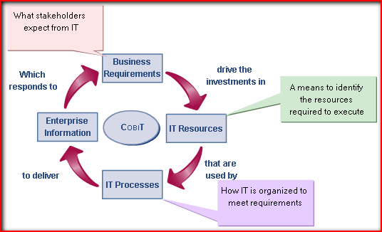
COBIT Framework

Slide 97
BS 25999
BS 25999 is a two-part British Standard published by British Standards Institution(BSI)
It illustrates what organizations should do to establish demonstrably robust business continuity processes, and how they can evaluate their own processes or those of others who they depend on.
The BS25999 standard is formed in two parts.

Slide 98
BS 25999 -1
BS25999-1 was published in Nov 2006
it establishes the process, principles and terminology of BCM.
It provides a basis for understanding, developing and implementing business continuity within an organisation and in that organisation’s dealings with suppliers, customers and other organisations.
It enables the organisation to measure its own and others BCM capabilities in a consistent and recognised manner.
It applies to organisations of all sizes and sectors and is intended to be used by anyone who has responsibilities for business operations or the provision of services.

Slide 99
BS 25999 -2
BS 25999-2 it was published in November 2007.
It defines requirements for a management systems approach to BCM.
It specifies requirements for “planning, establishing, implementing, operating, monitoring, reviewing and improving a documented Business Continuity.

Slide 100
PCI DSS
PCI DSS stands for payment card industry data security standard.
This global security standard for information is designed to enhance control over credit card data to prevent fraud.
All businesses regardless of size must follow PCI DSS requirements if they accept credit card payments from the major brands like MasterCard, Visa.
For any organization that processes, stores, or transmits cardholder and payment data, PCI DSS compliance is required.

Slide 101
PCI DSS
The PCI DSS regulations are a group of operational and technical requirements designed to protect cardholder data.
They are effectively the broader rules surrounding payment processing.
The overall goal of PCI is to ensure that anyone processing, accepting, storing, or transmitting credit card data maintains a secure environment.

Slide 102
PCI DSS
The PCI SSC has outlined 12 requirements for handling cardholder data and maintaining a secure network.
Distributed between six broader goals, all are necessary for an enterprise to become compliant.

Slide 103
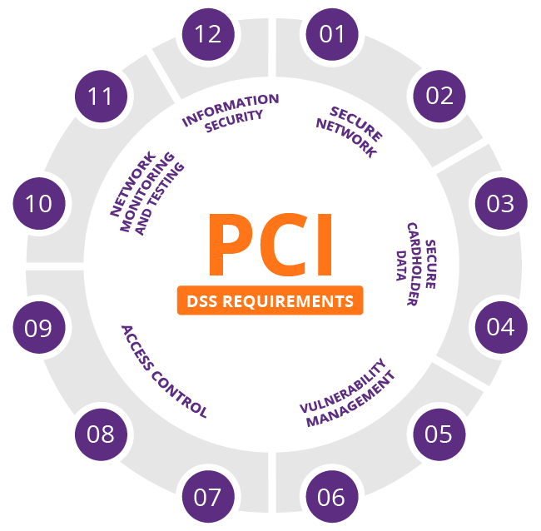
PCI DSS

Slide 104
ITIL Framework
Information Technology Infrastructure Library (ITIL) is provided with a framework of best practices for delivering IT services.
It enables organizations and individuals to deliver cost-effective IT Service Management, ITSM.
The ITIL is an appropriate method to management of IT service.
It can also help businesses manage risk, strengthen customer relations, establish cost-effective practices, and build a stable IT environment that provides for growth, scale and change.
ITIL is used to standardize the selection process, planning, and delivery and also standardize the maintenance of IT services within a business.
The goal of the ITIL is to improve efficiency and achieve predictable service delivery.

Slide 105
ITIL Framework
Following is the ITIL service lifecycle stages
Service strategy
Facilitates organizations to set business goals and develop a strategy to meet customer requirements and priorities.
Service design
Includes designing of processes and functions. This covers designing of service management processes, technology, infrastructure and products.
Service Transition
Focuses on maintaining the current state of service while deploying new organizational change. It ensures that risk and impact are in control so that there are no interruptions to any ongoing services.

Slide 106
ITIL Framework
Service Operation
Service operation ensures day to day operational tasks are seamless and is responsible for monitoring infrastructure and application related services. This enables businesses to meet customer’s requirements and priorities.
Continual Service Improvement
This is a part of quality check that aims towards continuous improvement of processes in an incremental manner. This happens throughout the service lifecycle.

